Slide 1




Advanced Tree Structures – Part II
B-Trees, Heaps, Tries, Suffix Trees, Space-Partitioning Trees
Advanced Tree Structures
SoftUni Team
Technical Trainers
Software University
http://softuni.bg

Slide 2


Table of Contents
B-Trees
B-Tree, B+ Tree
Heaps
Binary Heap
Tries
Trie, Suffix Tree
Space-Partitioning Trees
Quad-Tree, K-d Tree, BSP Tree

Slide 3
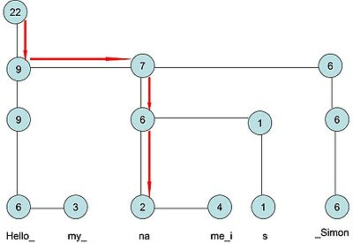


Rope
Rope == balanced tree for indexed items with fast insert / delete
Allows fast string edit operations on very long strings
Rope is a binary tree having leaf nodes
Each node holds a short string
Each node has a weight value equal to length of its string

Slide 4
Ropes in Practice: When to Use Rope?
Ropes are efficient for very large strings
E.g. length > 10 000 000
For small strings ropes are slower!
List<T> and StringBuilder performs better for 100 000 chars
Ropes provide:
Faster insert / delete operations at random position – O(log(n))
Slower access by index position – O(log(n))
Arrays provide O(1) access by index

Slide 5


Rope (Wintellect BigList<T>)
Live Demo

Slide 6
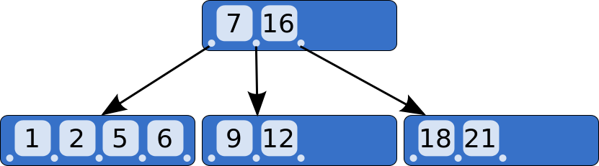
B-Trees
B-Tree, B+ Tree

Slide 7
What are B-Trees?
B-trees are generalization of the concept of ordered binary search trees – see the visualization
B-tree of order b has between b and 2*b keys in a node and between b+1 and 2*b+1 child nodes
The keys in each node are ordered increasingly
All keys in a child node have values between their left and right parent keys
If the B-tree is balanced, its search / insert / add operations take about log(n) steps
B-trees can be efficiently stored on the hard disk

Slide 8
B-Tree – Example
B-Tree of order 2 (also known as 2-3-4-tree):
17
21
7
11
18
20
26
31
4
5
6
8
9
12
16
22
23
25
27
29
30
32
35

Slide 9
B-Trees vs. Other Balanced Search Trees
B-Trees hold a range of child nodes, not single one
B-trees do not need re-balancing so frequently
Unlike other self-balancing search trees (like AVL, AA and Red-Black)
B-trees may waste some space (memory)
Since nodes are not entirely full
B-Trees are good for database indexes
Because a single node is stored in a single cluster of the hard drive
Minimize the number of disk operations (which are very slow)

Slide 10
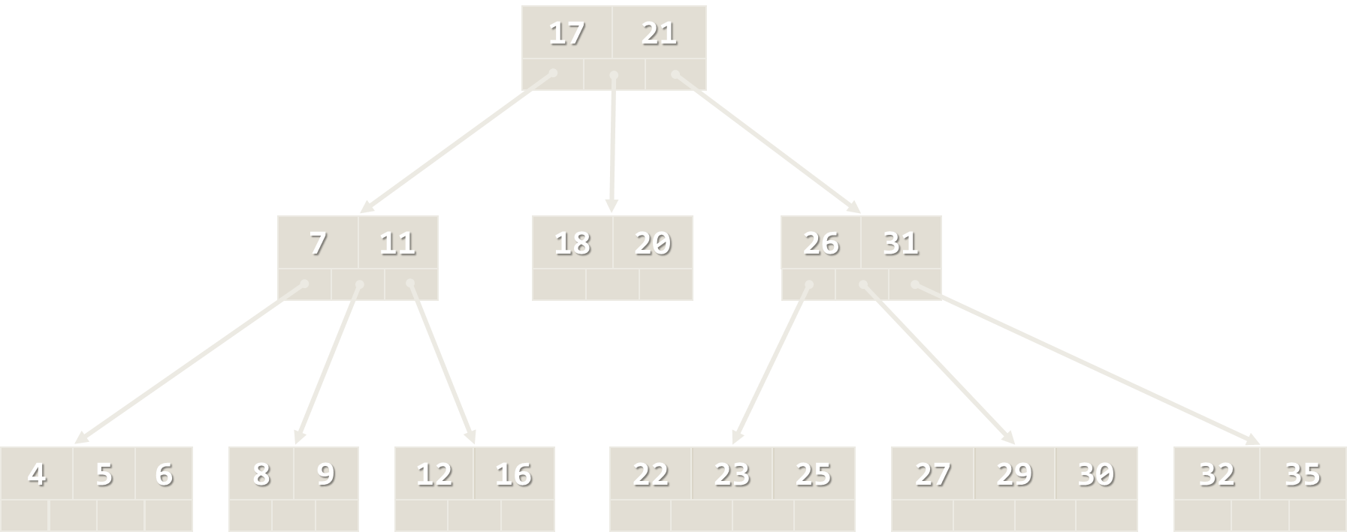
Implementation of B-Tree
Live Demo

Slide 11
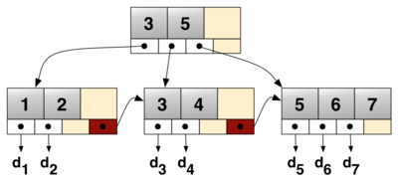
B+ Tree
B+ tree is a special kind of B-tree
Internal nodes hold keys + children + links
Leaf nodes hold keys only + links
Nodes at each level are linked in a doubly-linked list
B+ tree is used for storing data for efficient retrieval in block-oriented storage context, e.g. in file systems and databases
B+ tree has a lot of pointers to child nodes in a node
Reduces the number of I/O operations to find an element
Many file systems and RDBMS use B+ trees for efficiency

Slide 12
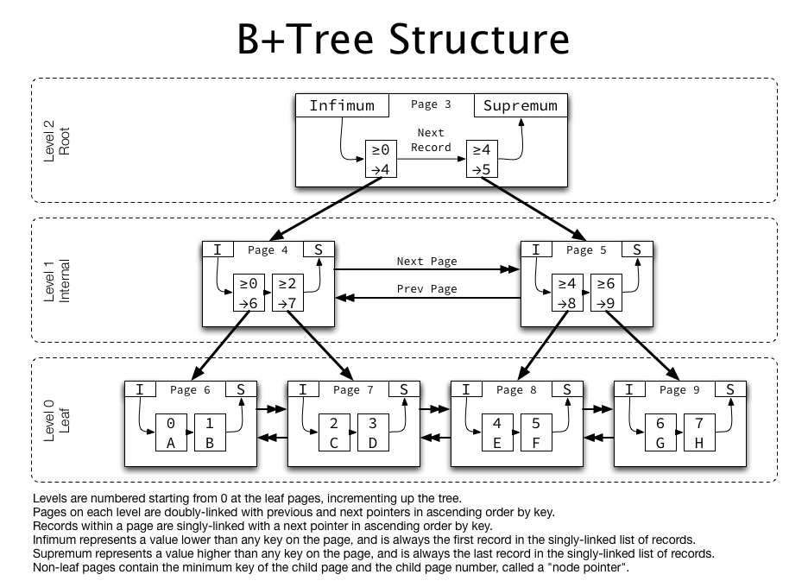
B+ Tree – Example

Slide 13
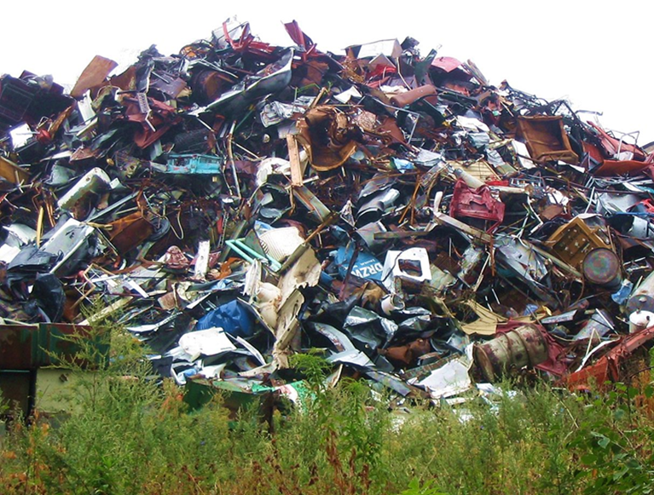
Priority Queue and Heaps
Heap, Binary Heap

Slide 14
Priority Queue
Priority queue in an abstract data type (ADT) that supports:
Insert-with-Priority(element, priority)
Pull-Highest-Priority-Element() → element
Peek-Highest-Priority-Element() → element
In C# and Java usually the priority is passed as comparator
E.g. IComparable<T> in C# and Comparable<T> in Java
Priority queue can be efficiently implemented as heap
Any balanced search tree could work as well (e.g. AVL)

Slide 15
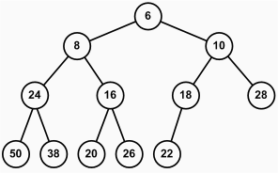
What is Heap?
Heap is a special type of balanced binary tree stored in array
Heap holds the "heap property": parent ≤ children
Each child node should be greater or smaller than its parent
Max Heap
The parent nodes are always greater or equal to the child nodes
Min Heap
The parent nodes are always less than or equal to the child nodes

Slide 16
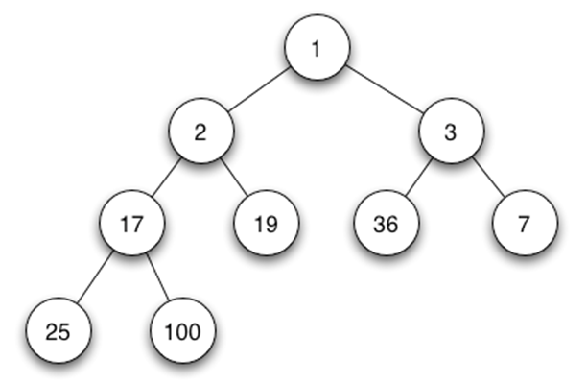
Binary Heap
Binary heap is a heap data structure representing a binary tree
Efficiently stored in a single array (no pointers at all)
Binary heap have two constraints:
Shape property: а binary heap is a complete binary tree
Heap property: all nodes are either greater than or equal to or less than or equal to each of its children
Binary heap efficiently implements a priority queue by binary tree stored as array

Slide 17
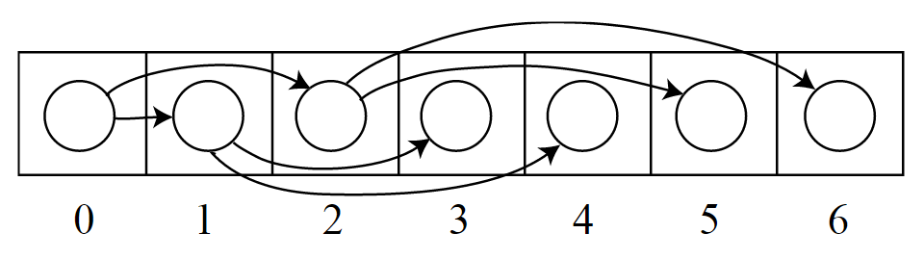
Binary Heap – Array Implementation
Binary heap can be efficiently stored in an array
Nodes 2*k and 2*k+1 have parent k
Operations:
Insert, Extract-Max, Build-Max-Heap
Heapify-Up, Heapify-Down

Slide 18
Binary Heap in Array: Tree Node Indexes
How to calculate the parent and children of given node i?
parent(i) = (i - 1) / 2
leftChild(i) = 2 * i + 1
rightChild(i) = 2 * i + 2

Slide 19
Binary Heap: Heapify-Down
Apply the "heap property" down from given node:
void Heapify-Down(heapArr, i)
left = leftChild(i); // 2*i + 1
right = rightChild(i); // 2*i + 2
largest = i;
if left < length(heapArr) && heapArr[left] > heapArr[largest]
largest = left;
if right < length(heapArr) && heapArr[right] > heapArr[largest]
largest = right;
if largest ≠ i
Swap(heapArr[i], heapArr[largest]);
Heapify-Down(largest);

Slide 20
Binary Heap: Heapify-Up
Apply the "heap property" up from given node:
Insert a new node:
void Heapify-Up(heapArr, i)
while hasParent(i) // i > 0
&& heapArr(i) > heapArr(parent(i)) // (i - 1) / 2
Swap(heapArr[i], heapArr[parent(i)]);
i = parent;
void Insert(heapArr, node)
heapArr.Append(node);
Heapify-Up(heapArr, lastElement(heapArr));

Slide 21
Binary Heap: Build-Max-Heap and Insert
Build a binary heap from array of elements:
Extract the max element from the heap:
void Build-Max-Heap(heapArr)
for i = length(heapArr) / 2 downto 1
Heapify-Down(heapArr, i)
void Extract-Max(heapArr)
max = heapArr[0];
heapArr[0] = delete last element from heapArr;
if length(heapArr) > 0
Heapify-Down(0);
return max;

Slide 22
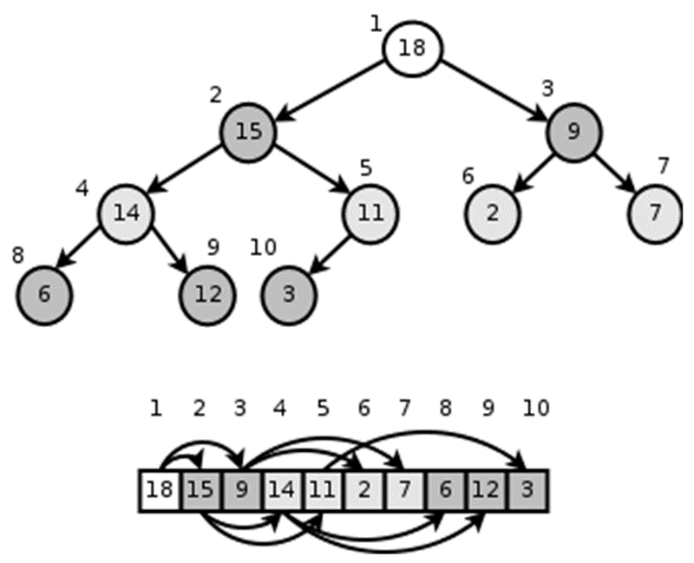
Implementing Binary Heap
Lab Exercise

Slide 23
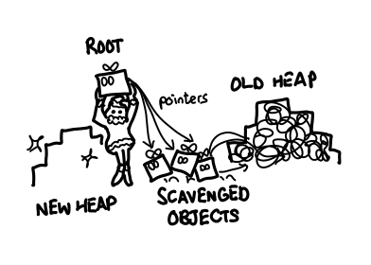
Other Heap Data Structures
Binomial heap
Fibonacci heap
Pairing heap
Treap
Skew heap
Soft heap
…

Slide 24
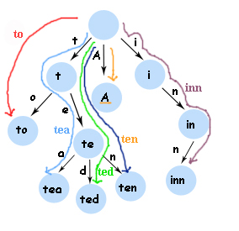
Tries
Trie and Suffix Tree

Slide 25
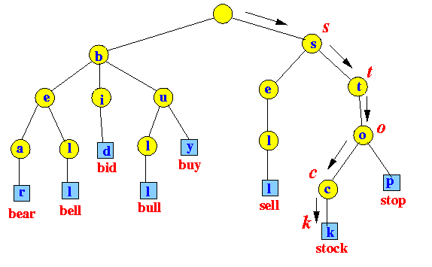
What is Trie?
Trie (radix tree or prefix tree) is an ordered tree data structure
Special tree structure used for fast multi-pattern matching
Used to store a dynamic set where the keys are usually strings
Applications:
Dictionaries
Text searching
Compression

Slide 26
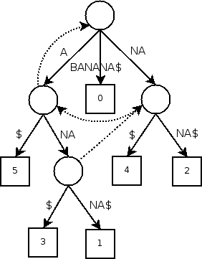
Suffix Tree
Suffix tree (position tree) is a compressed trie
Represents the suffixes of given string as their keys and positions in the text as their values
Used to implement fast search in string
Applications
String search
Finding substrings
Searching for patterns

Slide 27
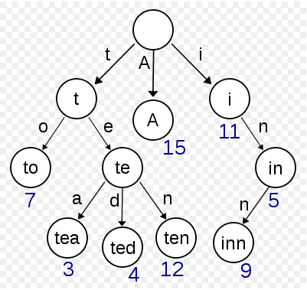
Trie – Implementation
Live Demo

Slide 28
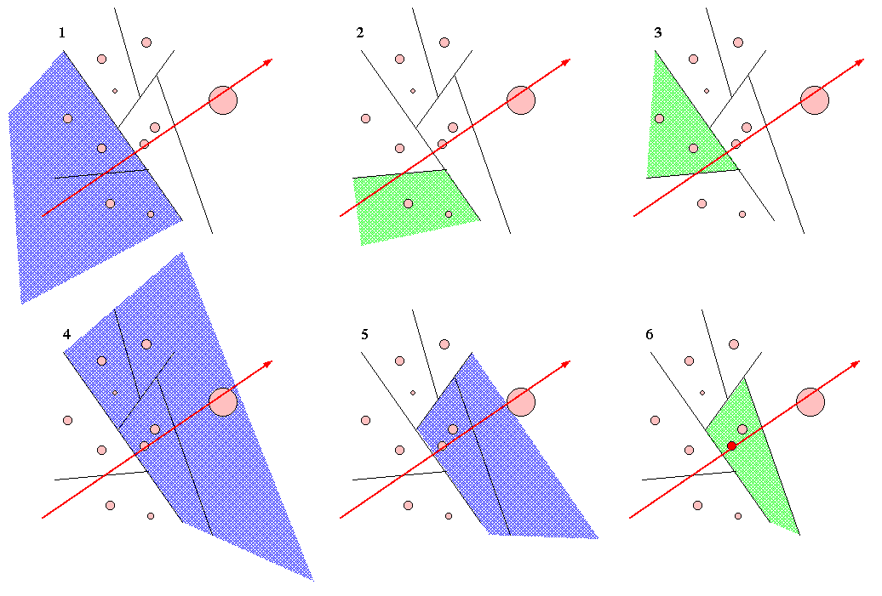
Space-Partitioning Trees
BSP-Tree, K-d Tree, Interval Tree

Slide 29
What is Space-Partitioning Tree?
Tree data structures used for:
Space partitioning – process of dividing a space into two or more subsets
Binary space partitioning – method for recursively subdividing a space into convex sets by hyperplanes
Applications:
Computer graphics
Ray tracing
Collision detection

Slide 30
Quad Trees
Quad-Trees are 2D space partitioning trees
Recursively divide space into quads (quadrants)
Each node has 0 or 4 children
Offer efficient bounds check for collision detection

Slide 31
Implementing Quad Tree
Lab Exercise

Slide 32
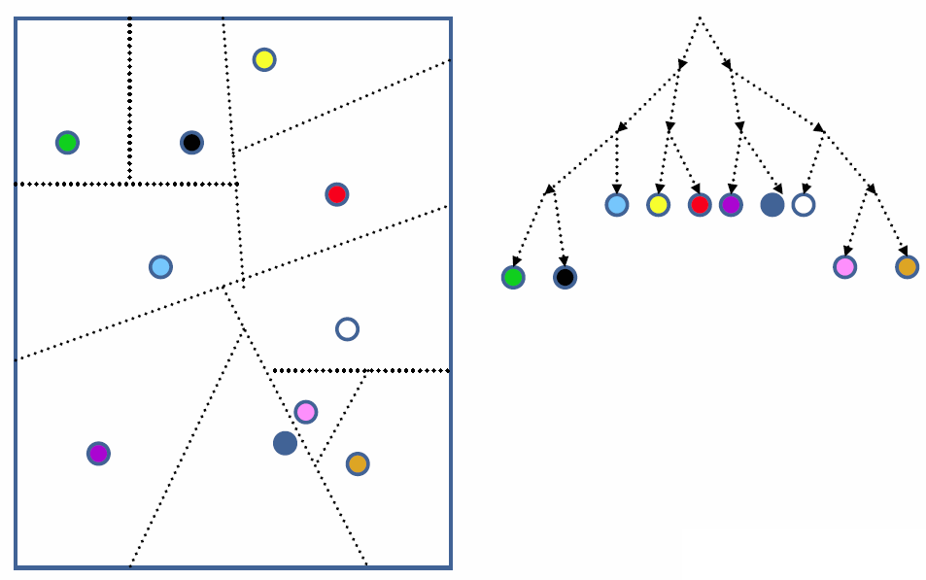
BSP-Tree
BSP tree is a hierarchical subdivisions of n dimensional space into convex subspaces
Each node has a front and back leaf
Starting off with the root node, all subsequent insertions are partitioned by the hyperplane of the current node
In 2D space, a hyperplane is a line
In 3D space, a hyperplane is a plane
Useful for real time interaction with displays of static images
BSP trees can be traversed very quickly (linear time) for its purposes

Slide 33
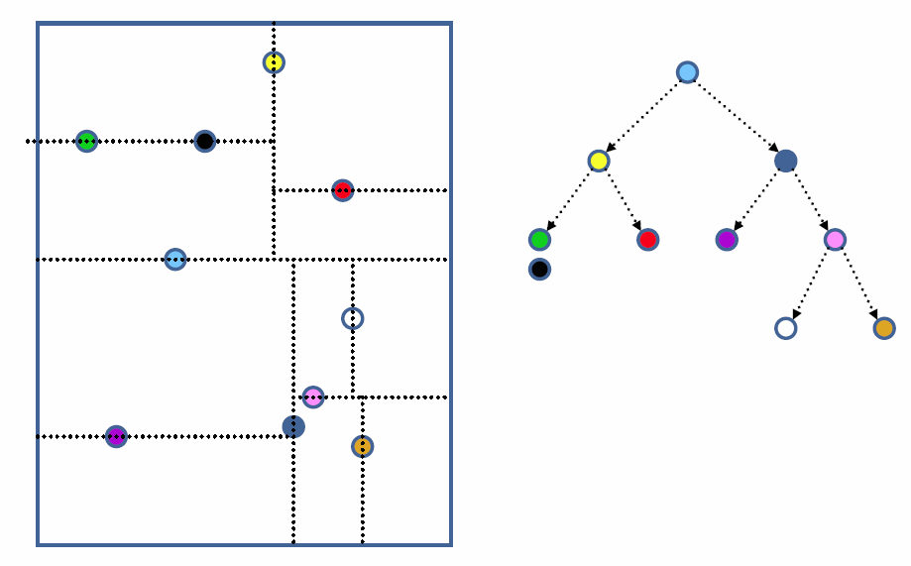
K-d Tree
K-d tree is a space-partitioning data structure for organizing points in a k-dimensional space
Еvery node is a k-dimensional point
Еvery non-leaf can be thought of as implicitly generating a splitting hyperplane
Hyperplane divides the space into two parts, known as half-spaces

Slide 34
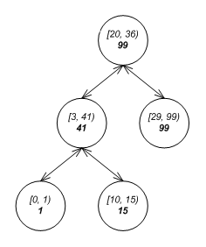
Interval Tree
Interval tree
Balanced tree data structure to hold intervals
Allows to efficiently find all intervals that
Overlap with any given interval or point
https://en.wikipedia.org/wiki/Interval_tree

Slide 35

Summary
Balanced binary search trees provide fast add / search / remove operations – O(log(n))
AA-Tree, AVL-Tree, Binary Tree, Rope
B-Trees are ordered trees that hold multiple keys in a single node
Heaps provide fast add / find-min / remove-min operations
Tries and suffix trees provide fast string pattern matching
Space-partitioning trees partition the space into hyperplanes
BPS-tree, K-d tree, interval tree

Slide 36









Advanced Tree Structures – Part II
https://softuni.bg/trainings/1308/data-structures-february-2016

Slide 37
License
This course (slides, examples, labs, videos, homework, etc.) is licensed under the "Creative Commons Attribution-NonCommercial-ShareAlike 4.0 International" license
Attribution: this work may contain portions from
"Fundamentals of Computer Programming with C#" book by Svetlin Nakov & Co. under CC-BY-SA license
"Data Structures and Algorithms" course by Telerik Academy under CC-BY-NC-SA license

Slide 38






Free Trainings @ Software University
Software University Foundation – softuni.org
Software University – High-Quality Education, Profession and Job for Software Developers
softuni.bg
Software University @ Facebook
facebook.com/SoftwareUniversity
Software University @ YouTube
youtube.com/SoftwareUniversity
Software University Forums – forum.softuni.bg

